Slide 1
Capstone Project E-commerce Project Submission Report
Submitted by :
Anitha Thirunavukkarasu
Date : 27 June 2025
Notes:
Good morning/afternoon, everyone. I’m Anitha Thirunavukkarasu, and I’m excited to present my Capstone Project on E-Commerce Analytics using Power BI.

Slide 2

Table of Contents
Business Objective
Project Overview
Problem Solving Methodology
Data Preparation & Clean-up
Feature Engineering : Creation of new KPIs
Visualization : An Insight into the data
Overview of charts used in Dashboard
Key Features
Challenges and Solutions
Data Sources and Tools
Conclusion
Notes:
Here’s a quick overview of the topics I’ll be covering in today’s presentation. We’ll start with the business objective and project overview, followed by the methodology I used to solve the problem. Then, I’ll walk you through how the data was prepared and how new KPIs were engineered.
We’ll explore the insights through data visualizations and understand the key charts used in the dashboard. After that, I’ll highlight key features, challenges encountered and how I solved them, the tools and data sources used, and finally wrap up with a conclusion and recommendations.
Let’s begin with the business objective.

Slide 3
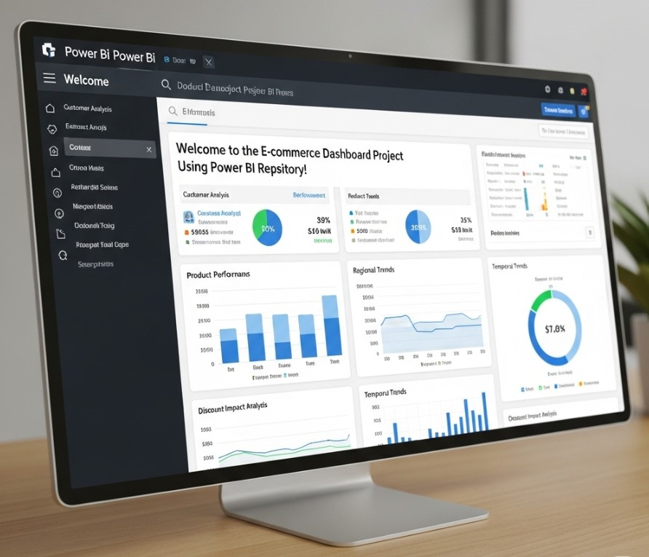

Notes:
This project focuses on transforming raw e-commerce data into valuable business insights. The key insights like product performance, regional trends, and customer behavior are visualized.
I chose to align my project context with companies like Shopee, which is one of Southeast Asia’s leading e-commerce platforms. My project aims to solve similar business challenges: understanding what products are performing well, how different regions behave, and where optimizations can improve profitability.

Slide 4

Business Objective
To enhance customer experience, expand the customer base, and increase revenue through data-driven insights and personalized product recommendations.
Notes:
Our primary business objective is to enhance the customer experience, expand the customer base, and ultimately increase revenue by leveraging data-driven insights. We also aim to provide personalized product recommendations that are grounded in actual customer behavior.

Slide 5

Project Overview
This project focuses on visualizing e-commerce sales data to extract actionable insights.
The analysis includes top-performing customers, products, regional performance, and the impact of discounts on revenue and profits.
Analyze and monitor sales, profit, and customer behavior across countries.
Identify top-performing products and regions.
Support business decisions with actionable insights.
The goal is to create an interactive and professional dashboard using Power BI.
Key Metrics
Gross Sales
Gross Profit
Orders Received
Items Sold
Customer Acquisition
Country/Product Performance
Notes:
This project centres on visualizing e-commerce sales data. It helps us identify top customers, best-selling products, regional performance, and the impact of discounts on revenue. The key goal is to build an interactive Power BI dashboard that supports data-driven business decisions.

Slide 6
Problem Solving Methodology
The approach for this project has been designed to follow the CRISP DM (Cross-Industry Standard Process for Data Mining) Framework.
The various stages of the framework are represented below in a sequential flow:
Business Understanding
(To understand the project objectives and requirements from a business perspective.)
Data Preparation & Feature Engineering
(To collect the business data from source systems and doing data exploration.)
Data Preparation
(Prepare the data – Cleaning, transforming the data for modeling or analysis.)
Deployment
(deploying the dashboard so that it is available to end-users for decision making)
Evaluation
(To ensure the dashboard meets the business objectives)
Modelling
(Creating calculated columns, measures, KPIs, and visuals to explore patterns)
Notes:
I followed the CRISP-DM framework to structure the project. Starting with business understanding, I then cleaned and prepared the data, created new features using DAX, developed visual models, and finally deployed the insights via an interactive dashboard. This step-by-step approach ensured both technical and business alignment.

Slide 7


Slide 8
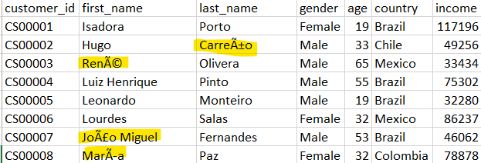
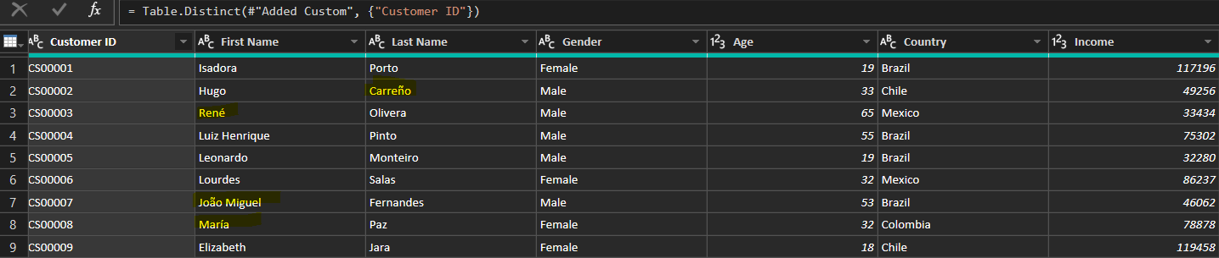
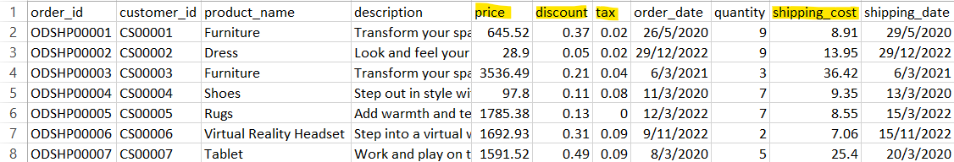
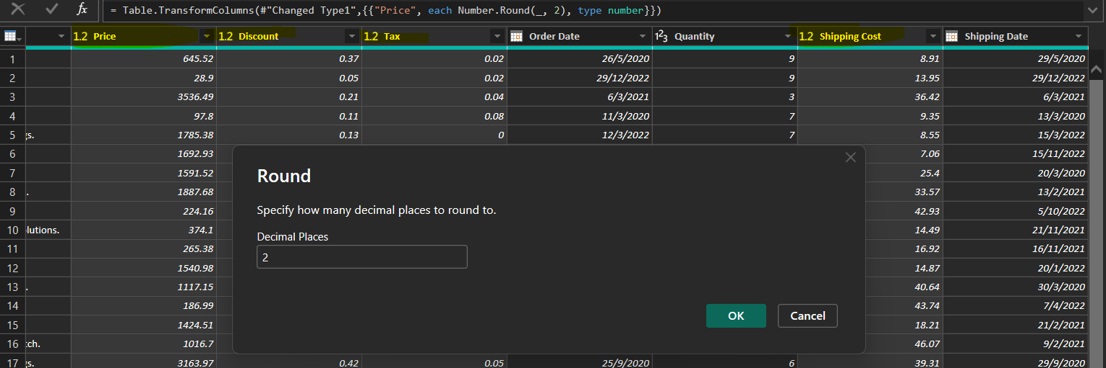
Data Preparation & Cleanup
Handling incorrect values in some columns
In the Customer table, specific character replacement was performed (e.g., "Ã" to "í" in "First Name").
Numerical columns (Price, Discount, Tax, Shipping Cost) in the Purchase table were rounded to 2 decimal places to ensure consistent formatting.
Notes:
During data cleaning, I addressed encoding issues like converting special characters in names.

Slide 9
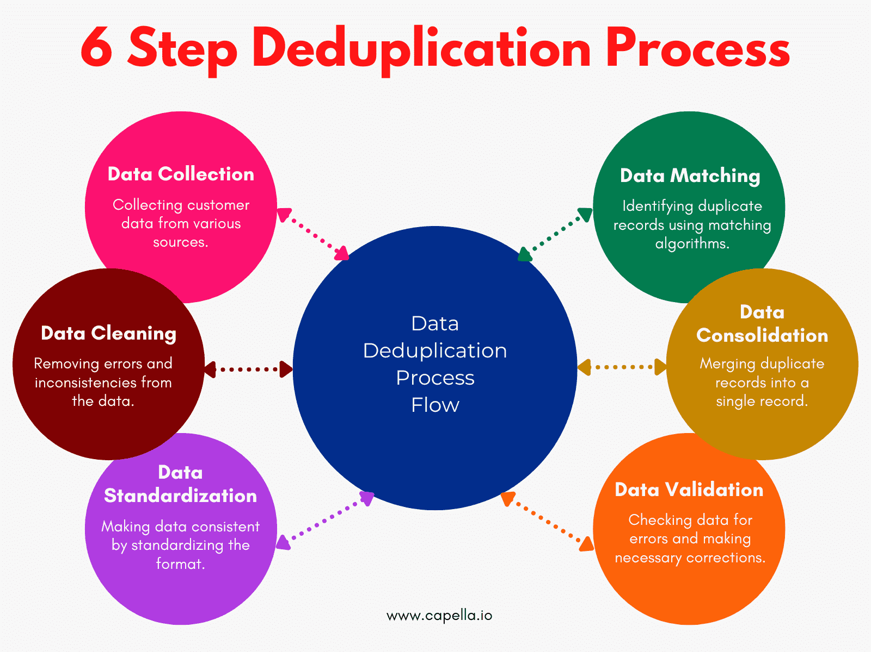
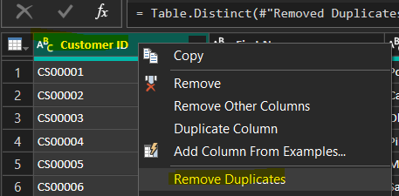
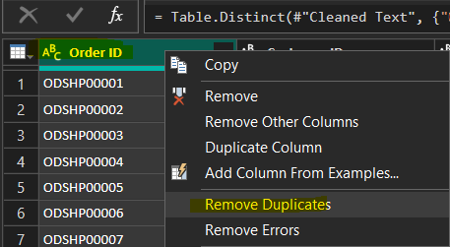
Data Preparation & Cleanup
De-Duplication of data
Duplicate records in the Customer table were removed based on the Customer ID column to ensure each customer is unique.
Duplicate records in the Purchase table were removed based on the Order ID column to ensure each order is unique.
Notes:
I also removed duplicates from both customer and purchase tables using unique identifiers.

Slide 10
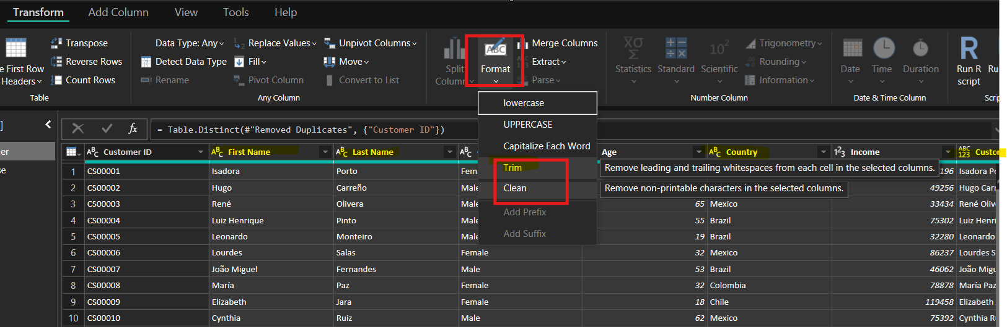

Data Preparation & Cleanup
Treating Null Values and Whitespaces
Text columns in both Customer (Customer ID, First Name, Last Name, Gender, Country) and Purchase (Order ID, Customer ID, Product Name, Description) tables were trimmed to remove leading/trailing whitespaces.
Clean function applied to First Name, Last Name in Customer table and Description in Purchase table to remove non-printable characters.
Notes:
Null values and extra spaces were cleaned to maintain data quality and consistency across the dataset.

Slide 11
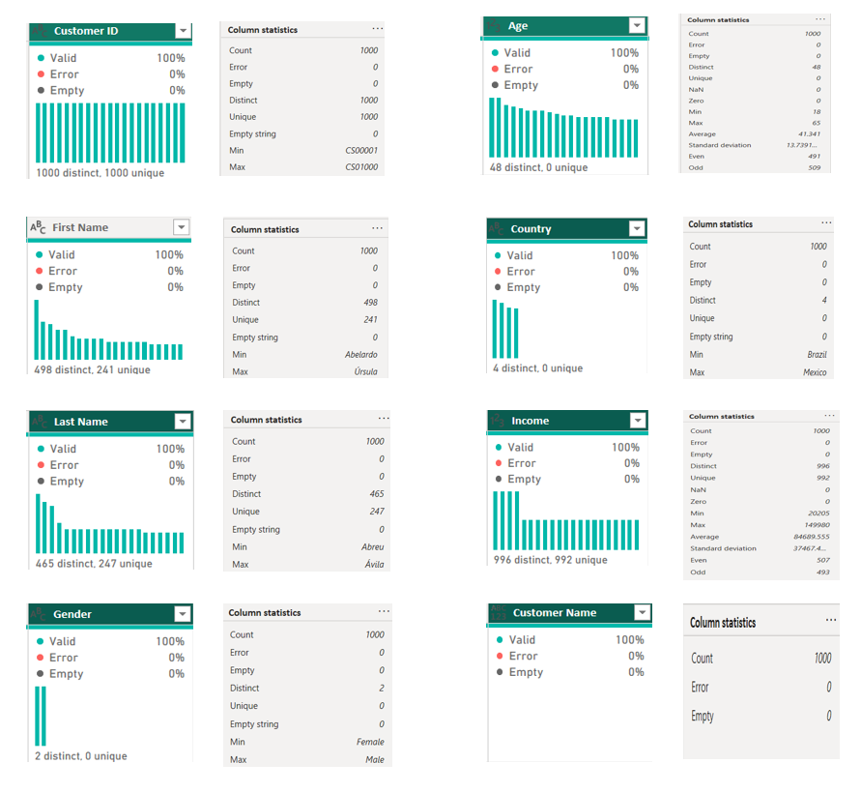
Data Preparation & Cleanup
C
U
S
T
O
M
E
R

Slide 12
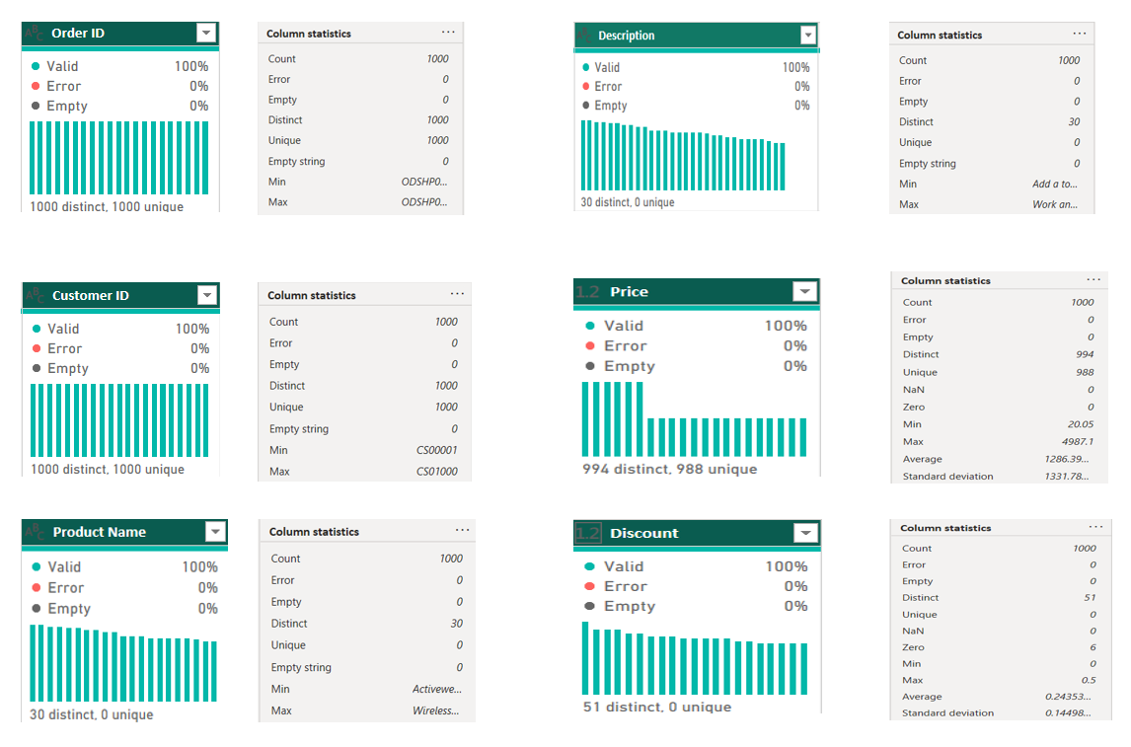
Data Preparation & Cleanup
P
U
R
C
H
A
S
E

Slide 13
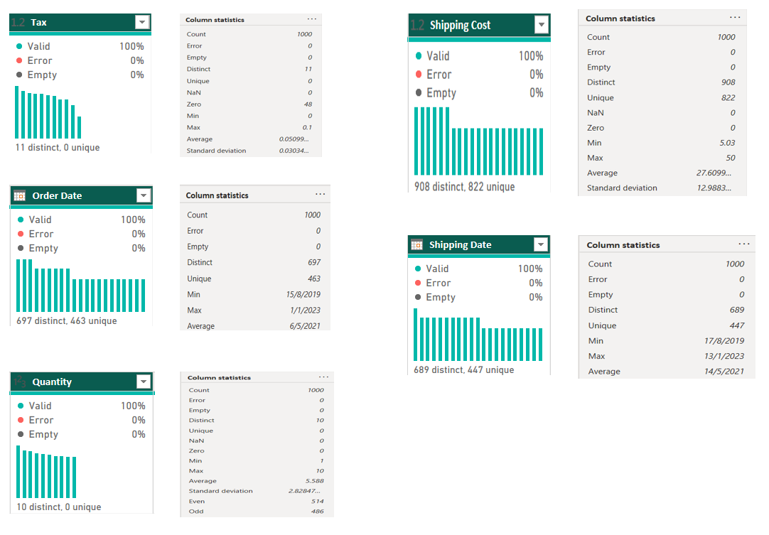
Data Preparation & Cleanup
P
U
R
C
H
A
S
E

Slide 14
Feature Engineering : Creation of new KPIs
Gross Sales
Price* Quantity
Orders Received
DISTINCTCOUNT(Order ID)
Items Sold
SUM(Quantity)
Total Customers
COUNTROWS(Customer)
Gross Profit
(
price –
(price * discount) * quantity
) * (1 - tax)
- 'Shipping Cost
YoY Growth
compares a specific period's data with the same period from the previous year. (sales, profit, orders ,shipping )
MoM Growth
compare a specific month's data with the data from the immediately preceding month . (sales, profit, orders ,shipping )
Sales by new customers
Check for new customer based on the order date if it falls within the date range selected. Extract sales amount only for the customer =1
Profit by new customers
Check for new customer based on the order date if it falls within the date range selected. Extract profit only for the customer =1
Avg. Profit per order
Gross Profit/Orders Received
Avg. days to deliver
AVERAGE(DATEDIFF( Order Date, Shipping Date , DAY) )
Avg. Profit on Shipments
(Price* Quantity ) – Shipping cost - (Price* Quantity* tax )
Notes:
To go beyond basic analysis, I created custom KPIs such as Year-over-Year and Month-over-Month growth, average profit per order, and profit by new customers. These KPIs allowed us to track detailed performance trends and customer behavior over time.

Slide 15
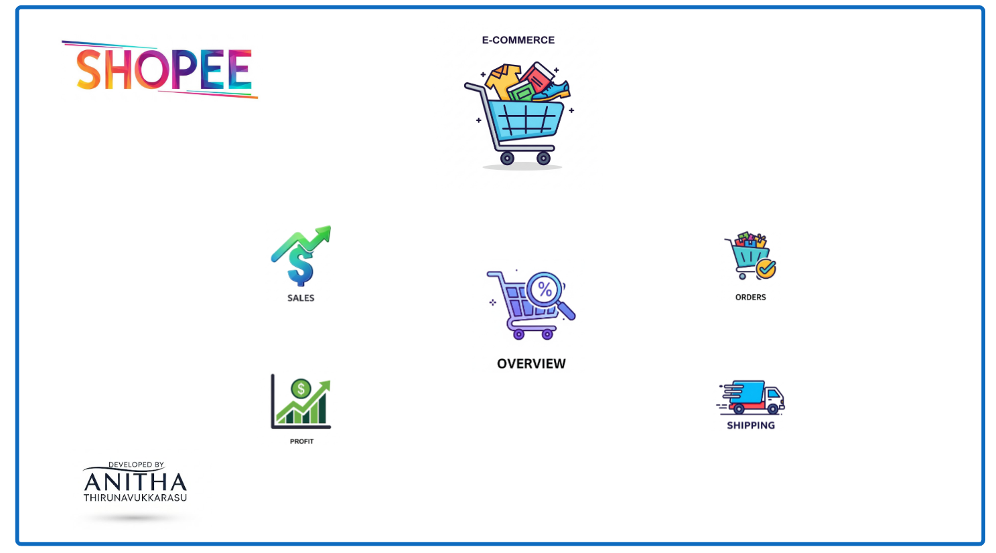
Visualization : An Insight into the data
This Power BI project is a comprehensive E-Commerce Analytics Dashboard, designed to help stakeholders monitor and evaluate key business metrics including Sales, Orders, Profits, and Shipping.
The dashboard is user-friendly and categorized into five distinct sections, each visually represented with intuitive icons for easier navigation and analysis.

Slide 16
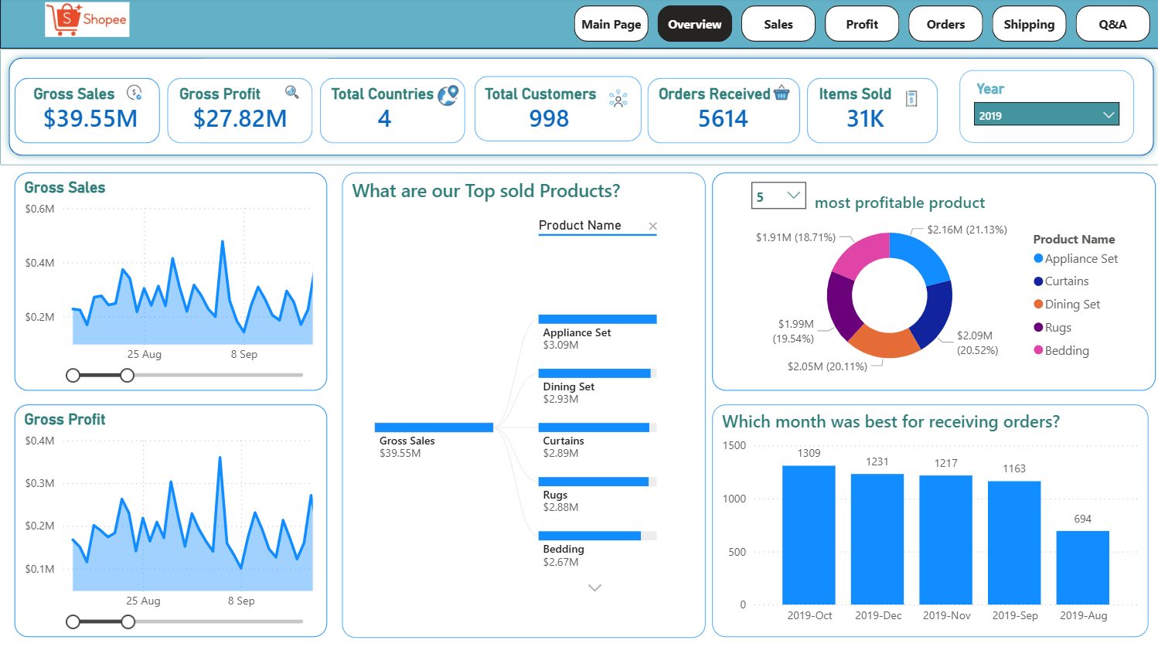
Visualization : An Insight into the data (contd …)
Overview Data Analysis ﻿
Gross Sales trended up, resulting in a 43.73% increase between Thursday, August 15, 2019 and Sunday, January 1, 2023.﻿﻿ ﻿﻿
﻿﻿Gross Sales started trending down on Thursday, May 28, 2020, falling by 19.64% ($66,190.85000000003) in 7.73 months.﻿﻿ ﻿﻿ ﻿﻿
﻿﻿Gross Profit jumped from $142,507.662737 to $218,661.153154 during its steepest incline between Saturday, April 16, 2022 and Thursday, May 19, 2022.﻿﻿ ﻿﻿
﻿﻿Gross Profit had several anomalies, both high and low, between Saturday, August 17, 2019 and Wednesday, December 28, 2022.﻿﻿ ﻿﻿ ﻿﻿
The most recent anomaly was on Wednesday, December 28, 2022, when Gross Profit had a low value of $101,439.768045.﻿﻿ ﻿﻿ ﻿
﻿﻿At 1362, 2020-Mar had the highest Order Count and was 2,995.45% higher than 2023-Jan, which had the lowest Order Count at 44.﻿﻿ ﻿﻿
﻿﻿Across all 42 Year-Month, Order Count ranged from 44 to 1362.﻿﻿ ﻿﻿ ﻿

Slide 17
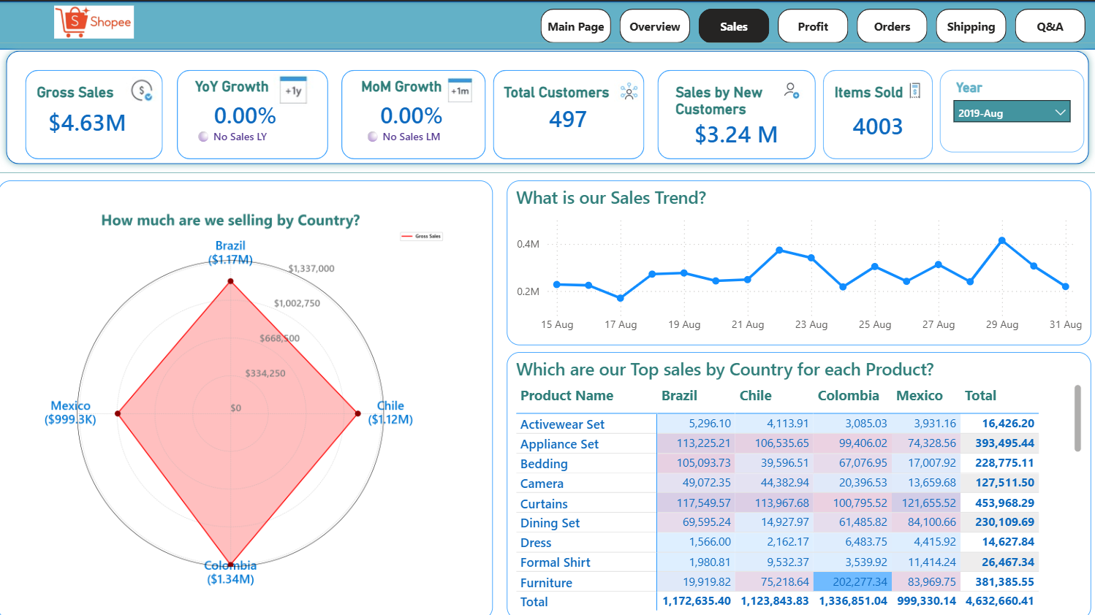
Visualization : An Insight into the data (contd …)

Slide 18
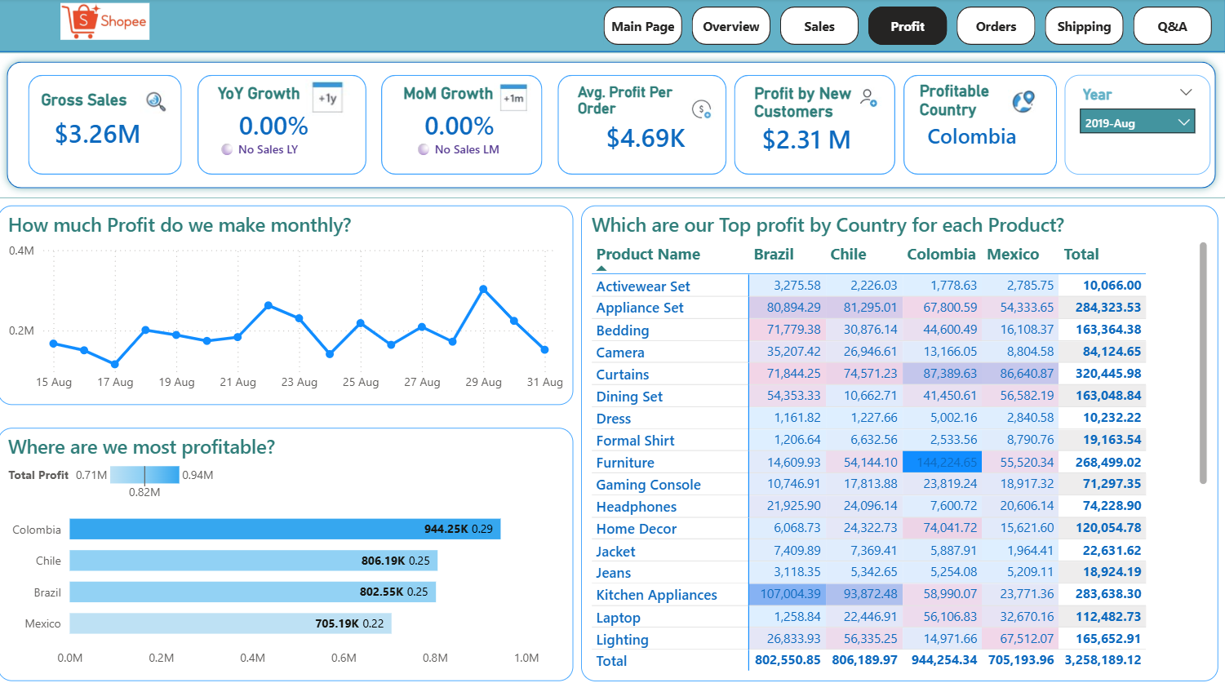
Visualization : An Insight into the data (contd …)

Slide 19
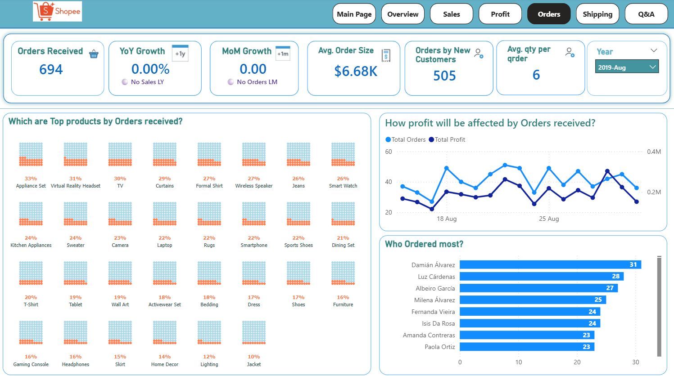
Visualization : An Insight into the data (contd …)

Slide 20
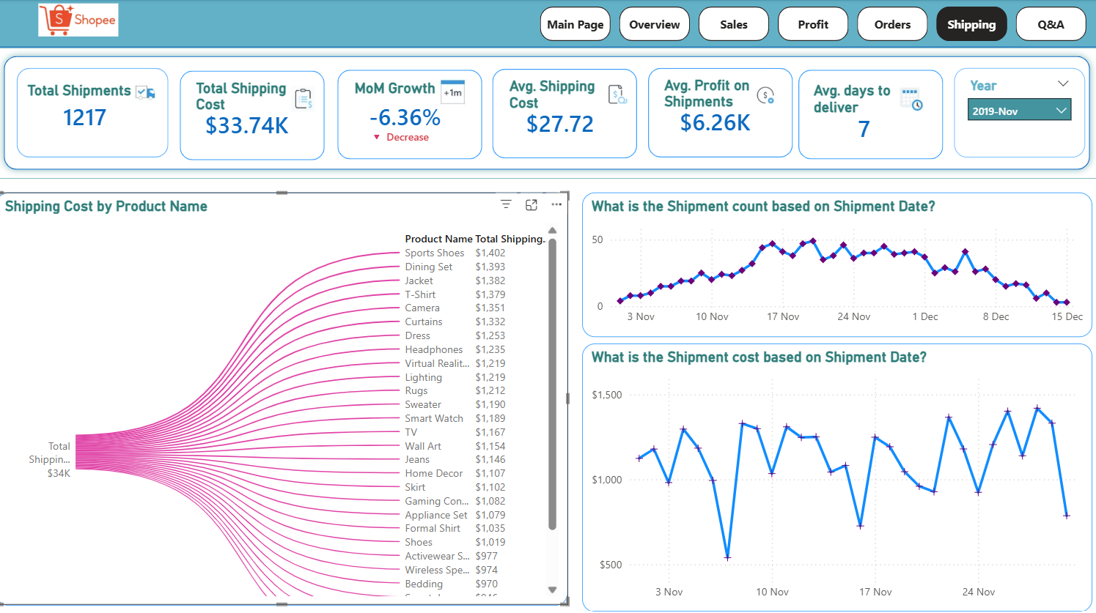
Visualization : An Insight into the data (contd …)

Slide 21
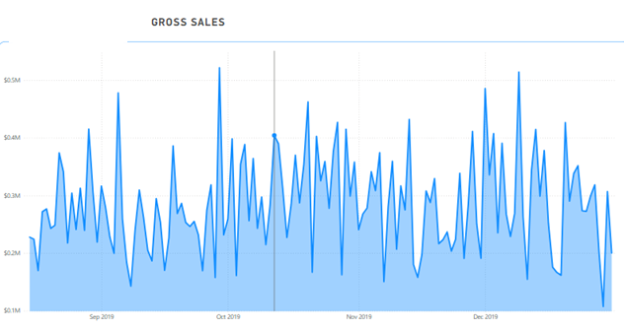
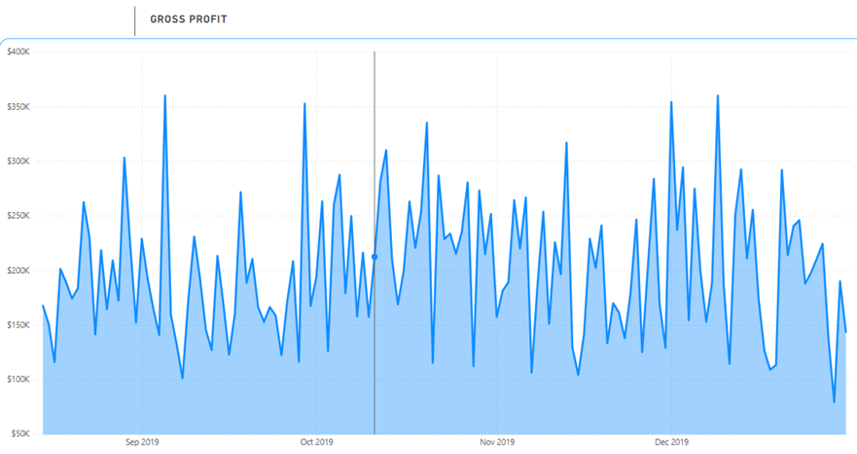
Visualization : An Insight into the data (contd …)
2019
﻿Gross Sales trended down, resulting in a 12.02% decrease between Thursday, August 15, 2019 and Tuesday, December 31, 2019.﻿﻿
﻿﻿Gross Sales started trending down on Thursday, December 12, 2019, falling by 41.80% ($143,831.9600000002) in 19 days.﻿﻿ ﻿﻿ Gross Profit dropped from $292,411.120346 to $143,505.335474 during its steepest decline between Friday, December 13, 2019 and Tuesday, December 31, 2019.﻿﻿ ﻿﻿ ﻿﻿
Gross Profit was unexpectedly high on Thursday, August 29, 2019. It had a value of $303,139.385709, which is outside the expected range of 152,945.98-257,906.22.﻿﻿ ﻿﻿ ﻿﻿
The most recent anomaly was on Thursday, August 29, 2019, when Gross Profit had a high value of $303,139.385709.﻿﻿ ﻿﻿ ﻿
﻿﻿At 1309, 2019-Oct had the highest Order Count and was 88.62% higher than 2019-Aug, which had the lowest Order Count at 694.﻿﻿ ﻿﻿
﻿﻿Across all 5 Year-Month, Order Count ranged from 694 to 1309.﻿﻿ ﻿﻿ ﻿

Slide 22
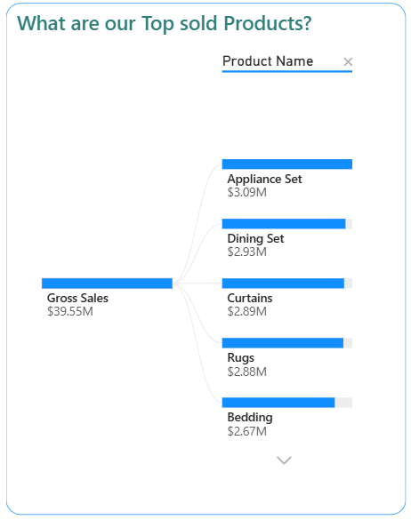
Visualization : An Insight into the data (contd …)
2019
﻿ "What are our Top sold Products?“
This chart provides the detail about top-selling products based on Gross Sales.
The total Gross Sales amount is $39.55 million.
This chart visualize the top selling products by their sales figures:
Appliance Set leads with $3.09 million in sales.
Dining Set follows closely at $2.93 million.
Curtains generated $2.89 million.
Rugs contributed $2.88 million.
Bedding recorded $2.67 million in sales.
This visualization helps in quickly identifying which products are driving the most revenue for the business.

Slide 23
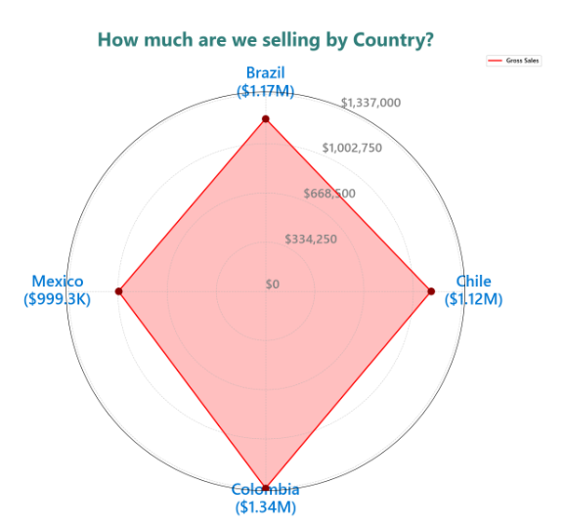
Visualization : An Insight into the data (contd …)
2019
﻿﻿ The concentric circles act as a scale, indicating values from the center ($0) outwards. In this chart, the scale increments are approximately $334,250, $668,500, $1,002,750, and $1,337,000, moving outwards from the center.
The red dots on each axis represent the "Gross Sales" value for that particular country. The further out the dot is from the center, the higher the value.
The red shaded area forms a polygon whose shape is indicative of the overall performance across all dimensions. A larger, more outward-extending shape indicates higher values across the board.
In this specific chart, Colombia is the furthest out on its axis, indicating the highest sales among the four countries. The shape's deviation from a perfect circle or a uniform polygon helps highlight strengths and weaknesses across the different countries.

Slide 24
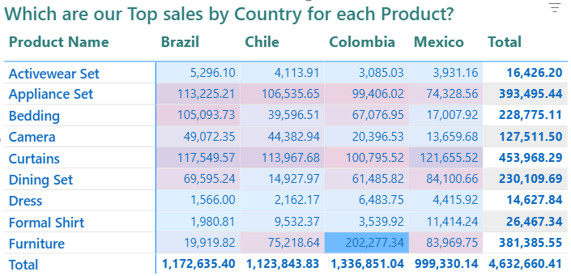
Visualization : An Insight into the data (contd …)
2019
﻿﻿ The chart displays sales data for various "Product Name" categories across four different countries: Brazil, Chile, Colombia, and Mexico.
It also includes a "Total" column, summarizing the sales for each product across all listed countries.
Key Sales Highlights by Product:
Curtains have the highest total sales at $453,968.29.
Furniture shows strong performance with $381,385.55 in total sales.
Key Sales Highlights by Country:
Colombia has the highest total sales among the countries, reaching $1,336,851.04.
The chart uses color shading to visually highlight sales performance, with a noticeable blue shade for higher sales values, indicating top performance in specific product-country .

Slide 25
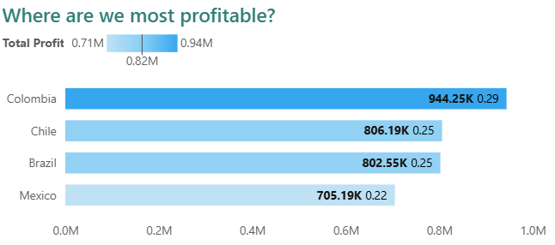
Visualization : An Insight into the data (contd …)
2019
"Where are we most profitable?“
The clustered bar chart uses horizontal bars to compare profit levels, with longer bars indicating higher profit.
There's a profit range indicated at the top, from $0.71M to $0.94M, with an average of $0.82M.
Colombia is the most profitable country, with a Total Profit of $944.25K.
Chile follows with $806.19K in profit.
Brazil shows a Total Profit of $802.55K.
Mexico is the least profitable among the four countries displayed, with $705.19K in Total Profit.
Each bar also displays a secondary numerical value (e.g., 0.29 for Colombia), which is the profit percentage.
This chart is effective in quickly identifying the geographical areas that contribute most to the company's profitability.

Slide 26
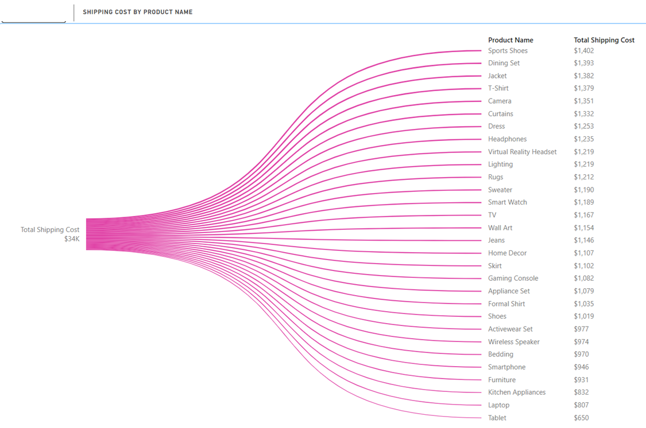
Visualization : An Insight into the data (contd …)
2019
“Shipping Cost by Product Name?“
The chart visualizes the total shipping cost of $34K, broken down by individual product names.
It shows how the total shipping cost branches out to various products, with each product listed alongside its respective shipping cost.
Sports Shoes incur the highest shipping cost at $1,402.
Dining Set follows with $1,393 in shipping cost.
The chart details the shipping costs for a comprehensive list of products, descending from highest to lowest. Some other products and their costs include Jacket ($1,382), T-Shirt ($1,379), Camera ($1,351), Curtains ($1,332), and Dress ($1,253), down to Laptop ($807) and Tablet ($650) as the lowest.
This chart is useful for understanding which products contribute most to overall shipping expenses, allowing for potential cost optimization strategies.

Slide 27
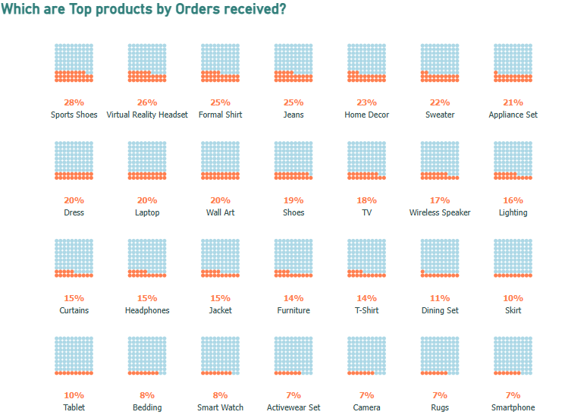
Visualization : An Insight into the data (contd …)
2019
"Which are Top products by Orders received?"
This chart displays a series of waffle charts to visualize the percentage of total orders received for various products.
Each product is represented by a 10x10 grid of squares, where each square typically represents 1% of the total, and the filled (orange) squares indicate the product's share of orders.
The chart clearly identifies the top products by order volume:
Sports Shoes account for 28% of orders received.
Virtual Reality Headset is next with 26%.
Formal Shirt and Jeans both represent 25% of orders.
Home Decor has 23%, Sweater has 22%, and Appliance Set has 21%.

Slide 28
Visualization : An Insight into the data (contd …)
Key Performance Indicator (KPI) chart visualizes data against a target or goal, allowing users to quickly assess progress and identify areas needing attention.
KPI Name | Description
🛒 Gross Sales | Gross sales refers to the total amount of money received from all sales of goods or services before any deductions for returns, allowances, or discounts.
💰 Gross Profit | Gross profit is the revenue remaining after subtracting the cost of goods sold (COGS) , tax, discount from gross sales, indicating the profitability of a company's core operations before considering operating expenses.
👥 Customer Count | To track growth in customer base
📦 Orders Received | To Analyse demand over time
📈 Items Sold | To identify sales volume trends
🚚 Shipping Cost | To evaluate logistics and operational efficiency
KPI Name | Why It’s Used
🛒 Gross Sales | Measure revenue generation effectiveness
💰 Gross Profit | Understand profitability after costs
👥 Customer Count | Track growth in customer base
📦 Orders Received | Analyze demand over time
📈 Items Sold | Identify sales volume trends
🚚 Shipping Cost | Evaluate logistics and operational efficiency

Slide 29
Visualization : An Insight into the data (contd …)
Area chart emphasizes the total value and change over time. It is typically used for data that represents a trend, like profit over time.
A line chart with the area under the line shaded, highlighting the magnitude of change.
Gross Sales - To visualize the sales over time (from Overview page)
Gross Profit - To visualize the profit over time (from Overview page)
KPI Name | Why It’s Used
🛒 Gross Sales | Measure revenue generation effectiveness
💰 Gross Profit | Understand profitability after costs
👥 Customer Count | Track growth in customer base
📦 Orders Received | Analyze demand over time
📈 Items Sold | Identify sales volume trends
🚚 Shipping Cost | Evaluate logistics and operational efficiency
Line chart line chart displays data points connected by lines, primarily used to show trends and changes over time. A line chart is a series of data points that are represented by dots and connected by straight lines. A line chart can have one or many lines.
Sales Trend - To visualize the sales over time on monthly basis (from Sales page)
Profit Trend - To visualize the profit over time on monthly basis (from Profit page)
Profit affecting Orders – To visualize the profit and order count on monthly basis (from Order page)
Shipment count – To visualize the shipment count based on shipment date on monthly basis (from Shipping page)
Shipping cost – To visualize the shipment cost based on shipment date on monthly basis (from Shipping page)
Decomposition chart is an interactive, hierarchical visual used to break down a metric (like sales, profit, or cost) across multiple dimensions. It helps users drill down step-by-step to understand what drives a key value.
Top sold products - To visualize and drill down the total sales amount by each product. (from Sales page)
Notes:
Time-Based Trends
Using line and area charts, I visualized trends in gross sales and profit over time. For example, sales peaked in early 2022 and then declined, highlighting seasonal impacts and possible business changes.
Product Performance
I used bar charts and decomposition trees to find top-selling and most profitable products. Appliance Sets and Curtains emerged as key contributors to revenue.

Slide 30
Visualization : An Insight into the data (contd …)
Donut chart is used to show the proportions of categorical data, with the size of each piece representing the proportion of each category.
To find most profitable product (with filters) - To visualize the profit amount for each product and their proportion. (from Overview page)
Clustered column chart is used to display and compare discrete values of multiple items across different categories, showing the values side-by-side within each category.
Best month for receiving orders - To visualize the order count based on order date (from Overview page)
Clustered bar chart is used to display and compare discrete values of multiple items across different categories, showing the values side-by-side within each category.
Which country has most profit - To visualize the gross profit by country. The colors for bar are displayed as gradient. Low profit value with light color and the highest profit value with dark color. (from Orders page)
Which customer has ordered most - To visualize the most ordered customer name.
Notes:
Regional Performance
The spiral and clustered bar charts reveal that Colombia and Brazil lead in both sales and profits. Mexico shows room for growth, which suggests potential for targeted marketing.”
Customer Insights
I also analyzed customer loyalty by identifying the most frequent buyers. This helps with planning retention strategies and loyalty programs.

Slide 31
Visualization : An Insight into the data (contd …)
Python visual chart is used to create advanced, customized, or statistical visualizations that go beyond Power BI's built-in visuals, leveraging Python libraries like Matplotlib, Seaborn, or Plotly for deeper insights.
Gross sales by country - To visualize the total sales amount by country in spiral order. This view will give detailed information on how far our sales is from other country values. Each spiral was assigned a value automatically and we can understand clearly on how far our sales amount are from 0 or mid value. (from Sales page)
Matrix chart is used to handle multiple dimensions (more than just rows and columns) and allows for hierarchical drill-down and up, making it suitable for analyzing complex data.
Top sales by country and by product - To visualize the gross sales of each product and by each country. (from Sales page)
Top profit by country and by product - To visualize the gross profit of each product and by each country. (from Profit page)
Notes:
Shipping Analysis
Shipping cost was highest for Sports Shoes and Dining Sets. Monthly shipment trends also help optimize logistics and reduce operational costs.
Special Visuals
I used advanced visuals like Python charts and waffle charts to display comparative data in a visually engaging way, helping stakeholders easily grasp proportions and differences.

Slide 32
Visualization : An Insight into the data (contd …)
Waffle chart is a custom visual that displays data as a 10x10 grid, with each square representing a percentage of the total value.
Top products by orders received - To visualize which products received the highest proportion of total orders in a percentage format, likely across countries. (from Orders page)

Slide 33
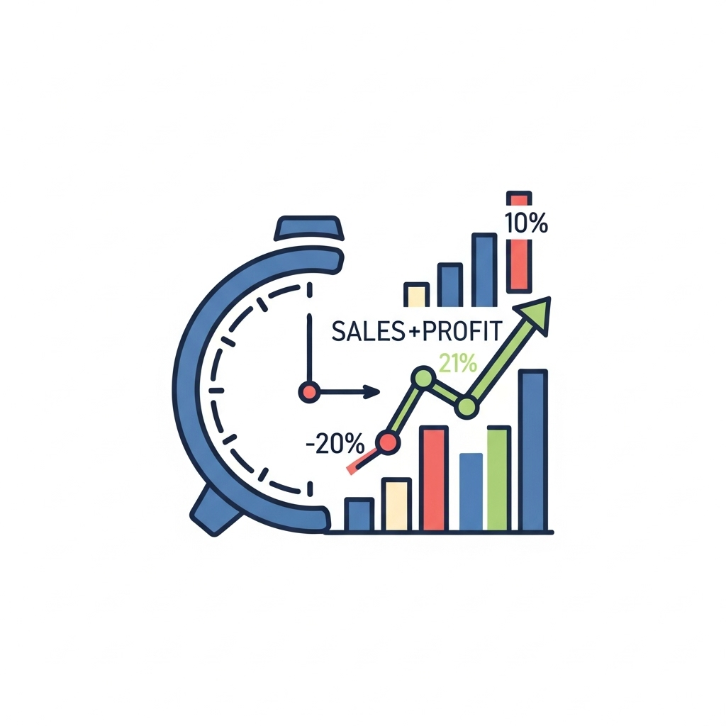
Key Features
Time-Based Sales & Profit Monitoring
Gross Sales & Gross Profit (Overview Page)
Line charts display revenue and profit trends over time.
Interactive slicers allow filtering by time periods (e.g., year/month).
Sales Trend & Profit Trend (Sales & Profit Pages)
Monthly-level trend analysis to track seasonal patterns and revenue consistency.
Profit vs. Orders (Order Page)
Combined visual shows how profit aligns with or diverges from order volumes monthly.
Shipping Count & Cost Trends (Shipping Page)
Monthly shipment volume and cost insights support operational and cost efficiency planning.
Notes:
The dashboard is organized into five clear sections, each focused on product performance, customer behavior, geography, shipping, and time-based analysis. All visuals are interactive, allowing users to slice the data based on filters.”

Slide 34
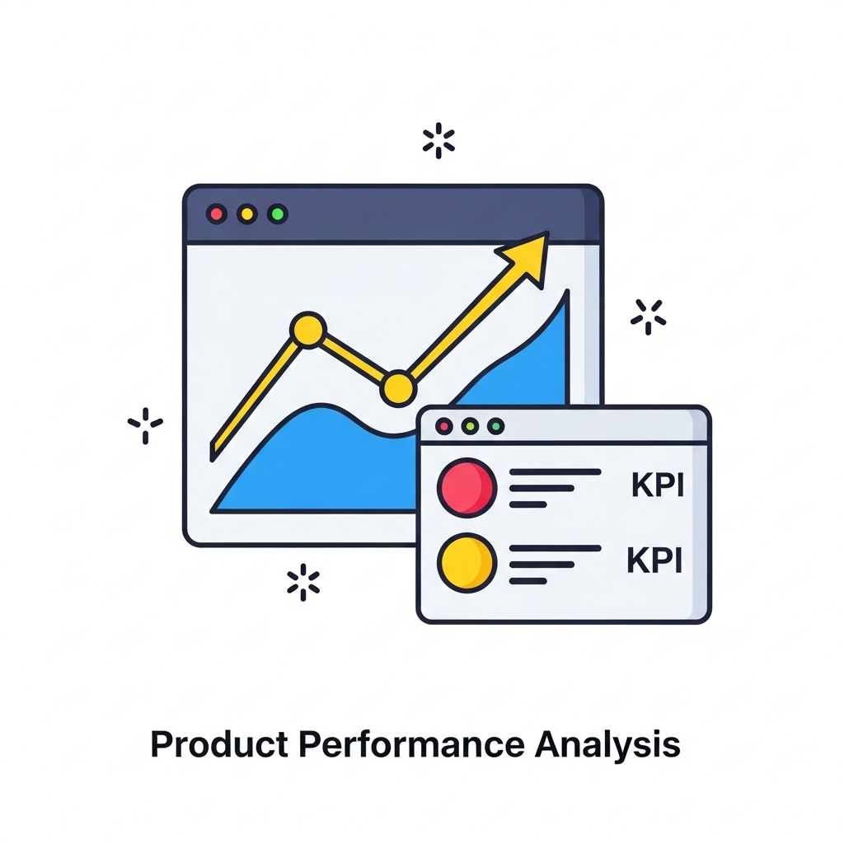

Key Features
Product Performance Analysis
Top Sold Products
Bar chart with drill-down allows exploration of which products drive most revenue.
Most Profitable Product (Overview Page)
Donut chart with percentages shows product-level profitability distribution.
Top Products by Orders
Visual shows which products are frequently ordered, useful for inventory forecasting.

Slide 35

Key Features
Geographical Insights
Gross Sales by Country (Spiral Chart)
Spiral layout visualizes relative sales values by country—quick visual cue for regional performance gaps.
Which Country Has Most Profit (Gradient Bar)
Gradient color-coded bar chart highlights countries with high vs. low profitability.
Top Sales & Profit by Country and Product
Matrix-style visuals show detailed breakdown by product per country, enabling region-specific targeting.

Slide 36

Key Features
Customer Behavior Insights
Most Ordered Customer
Identify loyal/high-frequency buyers to prioritize for loyalty programs or upselling.

Slide 37

Recommendations
Sales & Marketing
Focus on Appliance Set and Curtains for promotional
campaigns—they are consistently top in both sales and profit.
Run targeted campaigns by region:
Colombia and Brazil have the highest sales and profit.
Mexico shows potential for growth with additional
promotional efforts.
Notes:
We can break this into three talking points:
Marketing:
I recommend focusing marketing campaigns on top-performing products like Appliance Sets. These have consistently strong sales and profit margins.
Customer Retention:
We noticed a spike in new customer acquisition—especially around August. Offering discounts or personalized follow-ups can help convert these into repeat buyers.
Operational Efficiency:
Aligning stock levels with high-sales months, like October to December, can prevent stockouts. Also, reviewing shipping costs by product can help reduce overhead.

Slide 38
Recommendations
Customer Retention
Capitalize on high new customer acquisition (as per August dashboard)—convert them with loyalty perks, first-time discounts, or personalized offers.
Use customer segmentation to tailor follow-ups based on product interest and region.
Operational Efficiency
Align inventory and shipping logistics with peak order months (e.g., October–December).
Optimize shipping strategy using the monthly shipment count and cost data to reduce overhead.
Product Strategy
Discontinue or repackage underperforming products (e.g., Formal Shirt, Dress) based on sales matrix data.
Bundle top-selling products with medium performers to increase cross-sell opportunities.
Notes:
Marketing:
I recommend focusing marketing campaigns on top-performing products like Appliance Sets. These have consistently strong sales and profit margins.
Customer Retention:
We noticed a spike in new customer acquisition—especially around August. Offering discounts or personalized follow-ups can help convert these into repeat buyers.
Operational Efficiency:
Aligning stock levels with high-sales months, like October to December, can prevent stockouts. Also, reviewing shipping costs by product can help reduce overhead.

Slide 39

Challenges & Solutions
Challenges:
Data inconsistency across countries.
Performance issues with large datasets.
Solutions:
Used Power Query for cleansing.
Optimized DAX measures for performance.
Notes:
One challenge was inconsistent data formatting across countries. I resolved this using Power Query. Also, performance issues from large datasets were optimized through efficient DAX coding and proper data modelling.

Slide 40

Data Sources & Tools
Data Sources:
→ Sales transaction data from multiple countries
→ Customer purchase records
Tools:
→ Power BI Desktop (data modelling, visuals)
→ Power Query for data transformation
→ DAX for custom KPIs & measures
Notes:
I used sales and customer records from multiple countries. The tools include Power BI for visualization, Power Query for transformation, and DAX for calculating custom KPIs and metrics.”

Slide 41

Conclusion
Power BI dashboards provides us the clear, interactive, and
actionable insights across product, customer, and region dimensions.
It helps us to identify top-performing products,
best revenue-generating countries, and monthly sales trends.
It enables the data-driven decisions for marketing, inventory,
and operational strategy.
Overall, the dashboard provides a comprehensive view for
optimizing eCommerce performance and supporting business growth.
Notes:
To summarize, this Power BI dashboard empowers decision-makers with actionable insights across product, customer, and regional dimensions. It supports smarter inventory, marketing, and operational strategies. Thank you so much for your time, and I welcome any questions you may have.”

Slide 42

Notes:
Thank you for your time. I’m happy to take any questions.

